Slide 1

Statistical Methods:
Maximum Likelihood Fits
Christian Veelken
christian.veelken@cern.ch

Slide 2

Outline
Introduction to Maximum Likelihood (ML) method
Comparison with Method of Least Squares / Linear Regression
Pros & Cons of ML method
Application of ML method to fits of binned distributions
Poisson distribution
Important probability distribution functions (PDFs)
Gaussian distribution
Breit-Wigner distribution
Convolution of PDFs
Fourier transform
Christian Veelken Statistical Methods: Maximum Likelihood Fits 2

Slide 3
Outline
Brief introduction to RooFit toolkit
☞ Exercise
http://roofit.sourceforge.net/
Christian Veelken Statistical Methods: Maximum Likelihood Fits 3

Slide 4
Introduction to ML Method
Probability (density) to obtain exactly the value x_{n} in the n-th measurement
The Likelihood function
represents the probability (density) to obtain exactly the measured values x_{i} , assuming that the true value of the parameter, which we want to measure is r.
For a given set of measurements x_{i} , the likelihood function is a function of the parameter r .
Christian Veelken Statistical Methods: Maximum Likelihood Fits 4

Slide 5
Introduction to ML Method
The function L(r) is not a probability density in the parameter r , however, but it is a probability density in the measurements x_{i} .
Why is this important ?
Because a probability density in r would have a different normalization than a probability density in the measurements x_{i} .
It is important to ensure that the likelihood function L(r) has the proper normalization, of a probability density in the measurements x_{i} , for all values of r
which is fulfilled if the probability densities for all individual measurements x_{i} in the likelihood function satisfy the normalization condition
for all x_{i} and all r
Christian Veelken Statistical Methods: Maximum Likelihood Fits 5

Slide 6
Introduction to ML Method
According to the maximum likelihood principle, the best estimate for the parameter r is the value for which the likelihood function reaches its maximum, i.e. the value of r that maximizes the probability to observe exactly the measured values x_{i} .
This implies:
The value of r that maximizes L(r) is denoted by the symbol
In case the likelihood function depends on multiple parameters r_{i} , the above condition generalizes to
Best estimate for parameter r
for all r_{i}
Christian Veelken Statistical Methods: Maximum Likelihood Fits 6

Slide 7
Introduction to ML Method
To “fit the data” means to numerically find values of the parameters r_{i} such that the likelihood function L(r) gets maximized
(or equivalently, that -2∙ln( L(r) ) gets minimized)
The maximum of L(r) is attained at the same value of r_{i} as the minimum of -2∙ln( L(r) ) , due to the fact that the logarithm is a monotonic function
Using -2∙ln( L(r) ) provides the practical advantage that is allows to use standard tools for function minimization. The multiplicative factor 2 is merely a convention and has no influence on the result of the fit.
Christian Veelken Statistical Methods: Maximum Likelihood Fits 7

Slide 8
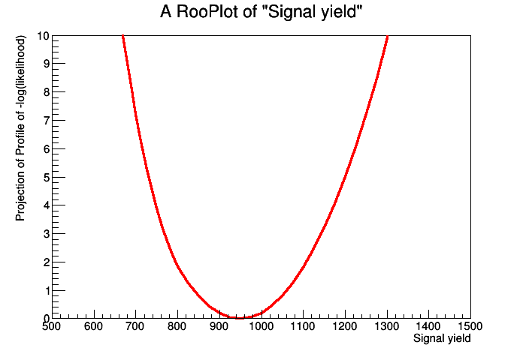

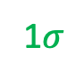
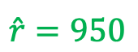
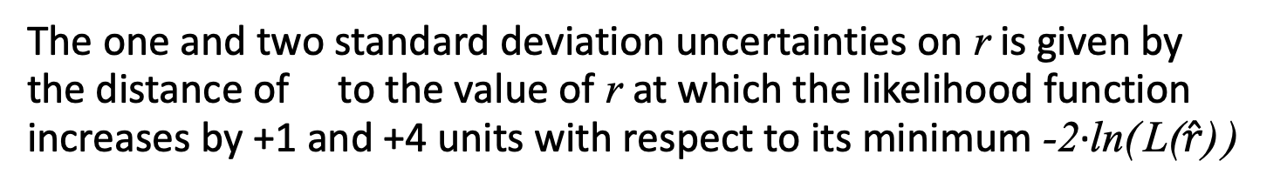
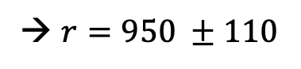
Introduction to ML Method
The one and two standard deviation uncertainties on r is given by the distance of to the value of r at which the likelihood function increases by +1 and +4 units with respect to its minimum -2∙ln( L($\hat{r}$) )
2$σ$
1$σ$
$$\hat{r}=950$$
→ $r=950 ±110$
Christian Veelken Statistical Methods: Maximum Likelihood Fits 8

Slide 9
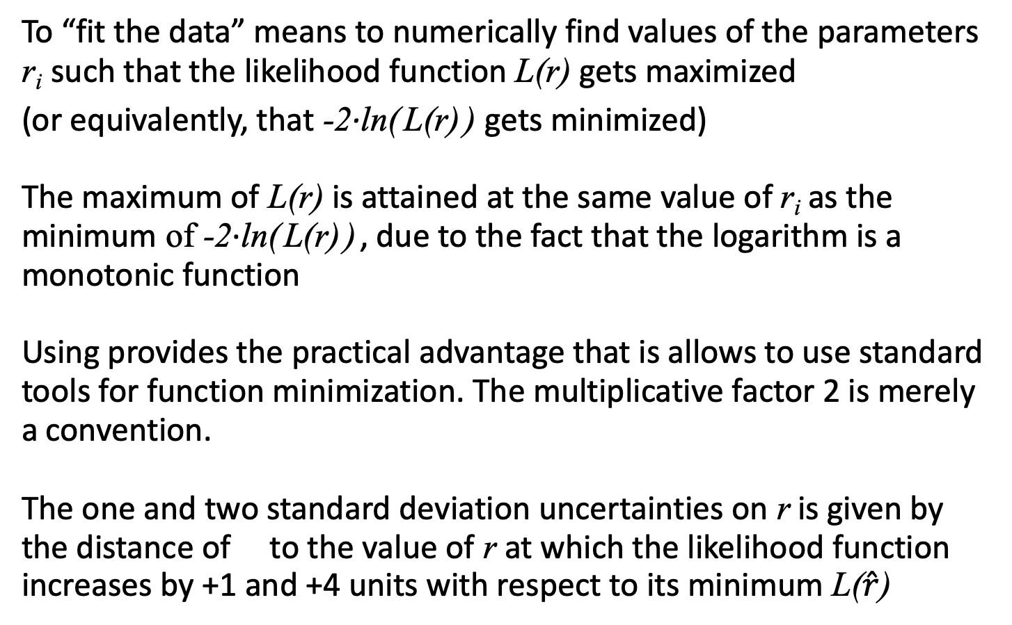
Introduction to ML Method
To “fit the data” means to numerically find values of the parameters r_{i} such that the likelihood function L(r) gets maximized
(or equivalently, that -2∙ln( L(r) ) gets minimized)
The maximum of L(r) is attained at the same value of r_{i} as the minimum of -2∙ln( L(r) ) , due to the fact that the logarithm is a monotonic function
Using provides the practical advantage that is allows to use standard tools for function minimization. The multiplicative factor 2 is merely a convention.
The one and two standard deviation uncertainties on r is given by the distance of to the value of r at which the likelihood function increases by +1 and +4 units with respect to its minimum L($\hat{r}$)
Christian Veelken Statistical Methods: Maximum Likelihood Fits 9

Slide 10
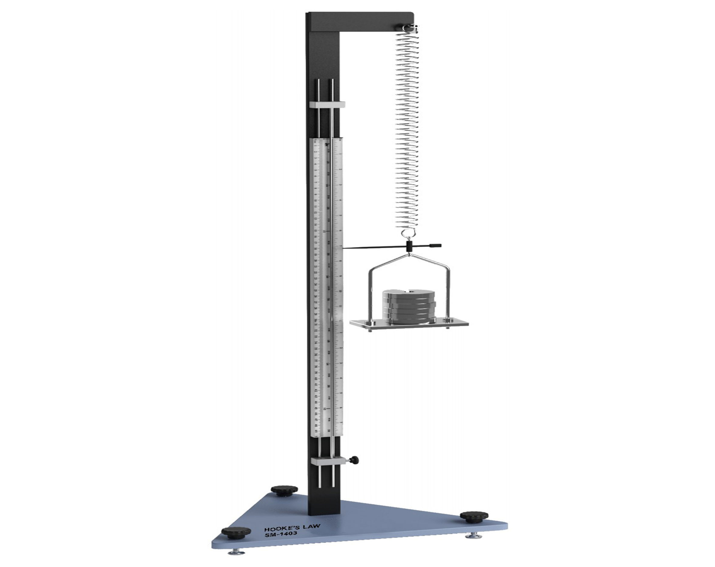
Comparison with Linear Regression
You may have used an apparatus such as this to measure the spring constant k in a laboratory course
The weight of the plates that are attached to the end of the spring is pulling the needle downwards, while the spring force is pulling the needle upwards
The spring force increases linearly as function of the elongation y of the spring.
The needle reaches equilibrium and stops moving when the weight and the spring force are of equal strength,
i.e.
Hook’s law
y
F = -k y
F = m g
with g = 9.81 m/s²
gravitational acceleration of the earth
Christian Veelken Statistical Methods: Maximum Likelihood Fits 10

Slide 11
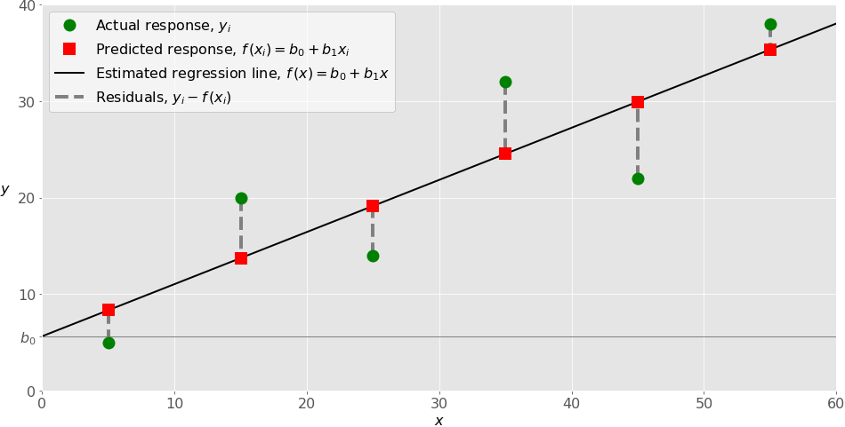
Comparison with Linear Regression
In a laboratory course you would measure the elongation y of the spring for different numbers x of plates that are attached to the end of the spring and then use linear regression to determine the spring constant k . The method of linear regression minimizes the sum of squares between the measurements y_{i} and the predicted
elongation , where m₀ denotes the weight of a single plate
= slope b₁
https://realpython.com/linear-regression-in-python/
Number of the plates that are attached to the end of the spring
Christian Veelken Statistical Methods: Maximum Likelihood Fits 11

Slide 12
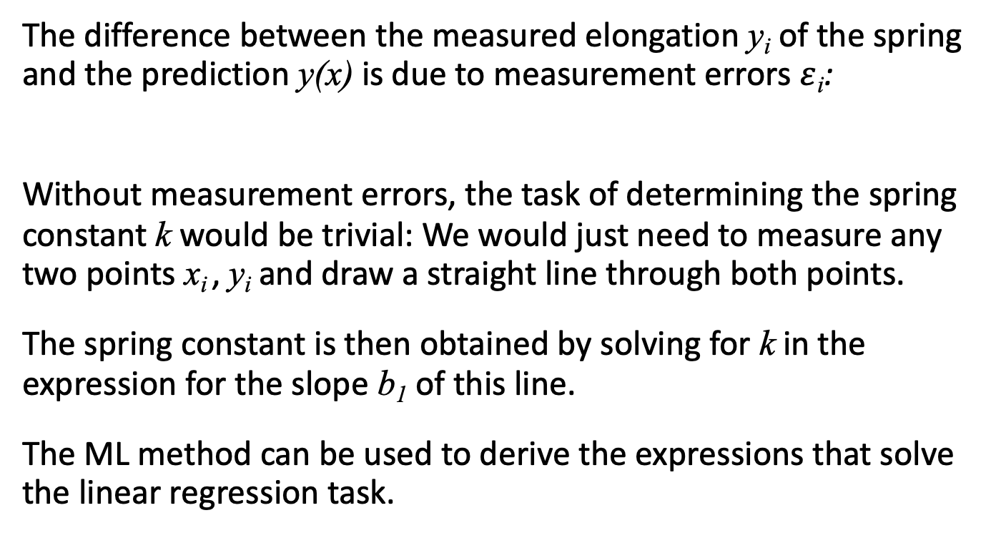
Comparison with Linear Regression
The difference between the measured elongation y_{i} of the spring and the prediction y(x) is due to measurement errors $ε$_{i}:
Without measurement errors, the task of determining the spring constant k would be trivial: We would just need to measure any two points x_{i} , y_{i} and draw a straight line through both points.
The spring constant is then obtained by solving for k in the expression for the slope b₁ of this line.
The ML method can be used to derive the expressions that solve the linear regression task.
Christian Veelken Statistical Methods: Maximum Likelihood Fits 12

Slide 13
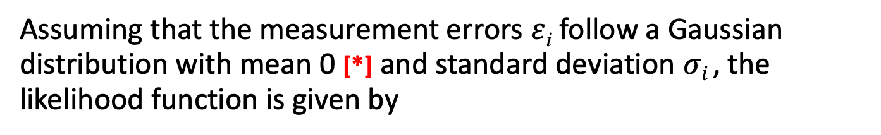
Comparison with Linear Regression
Assuming that the measurement errors $ε$_{i} follow a Gaussian distribution with mean 0 [*] and standard deviation $σi$ , the likelihood function is given by
This term can be ignored: since it does not depend on k , it has no influence on finding the value of k that minimizes the likelihood function
[**]
This is the term that gets minimized in the method of least squares, which you have used in laboratory courses
[*] i.e. the average difference between measured and predicted elongations
of the spring is zero, which means that the measurement is unbiased
[**] using log(a∙b) = log(a) + log(b)
Christian Veelken Statistical Methods: Maximum Likelihood Fits 13

Slide 14
Pros & Cons of ML Method
Pros
ML method provides a lot of flexibility to adapt to different probabilistic models when fitting the data, through the choice of a suitable probability density function (PDF)
ML method allows to incorporate “external” information into the fits (e.g. constraints on the parameters, which are obtained from data other than the data that is included in the ML fit)
Cons
If the wrong probabilistic model is used when fitting the data, the parameter values obtained from the fit can be strongly biased or make no sense at all (“wrong” here means that the probabilistic model used to fit the data is different from the “true” probabilistic model that generated the data)
→ It is important to compare the result of the ML fit with the raw
data to spot potential biases (this is called a “postfit” plot)
Christian Veelken Statistical Methods: Maximum Likelihood Fits 14

Slide 15
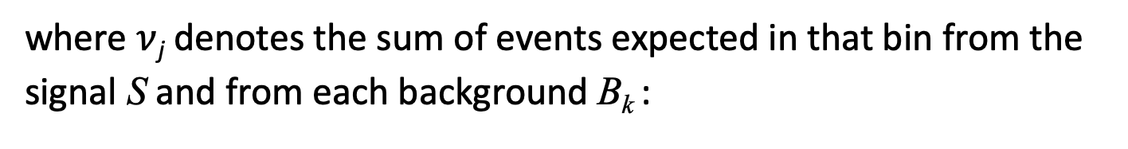
ML Fits of binned Distributions
The number N_{j} of events that is observed in a single bin j of the histogram is given by the Poisson distribution
where $ν$_{j} denotes the sum of events expected in that bin from the
signal S and from each background B_{k} :
Christian Veelken Statistical Methods: Maximum Likelihood Fits 15

Slide 16
ML Fits of binned Distributions
The number of events that are expected from the signal and from all backgrounds need to be computed by integrating the PDF for the signal and for the backgrounds over the range [a,b] of the bin
and
where and refer the shape of the distribution for signal and background k, respectively, and and denote the total number of events (= sum over all bins) expected from the signal and from background k
Christian Veelken Statistical Methods: Maximum Likelihood Fits 16

Slide 17
ML Fits of binned Distributions
The likelihood function L that we need to use in the ML fit is then given by the product of the Poisson probabilities over all bins j
☞ Important point
In the notation above, I have omitted the dependency of the
number of events and that are expected from the signal
and from each background k on the parameters , , and
This dependency is important, because our main motivation for performing the ML fit is to determine these parameters!
Christian Veelken Statistical Methods: Maximum Likelihood Fits 17

Slide 18
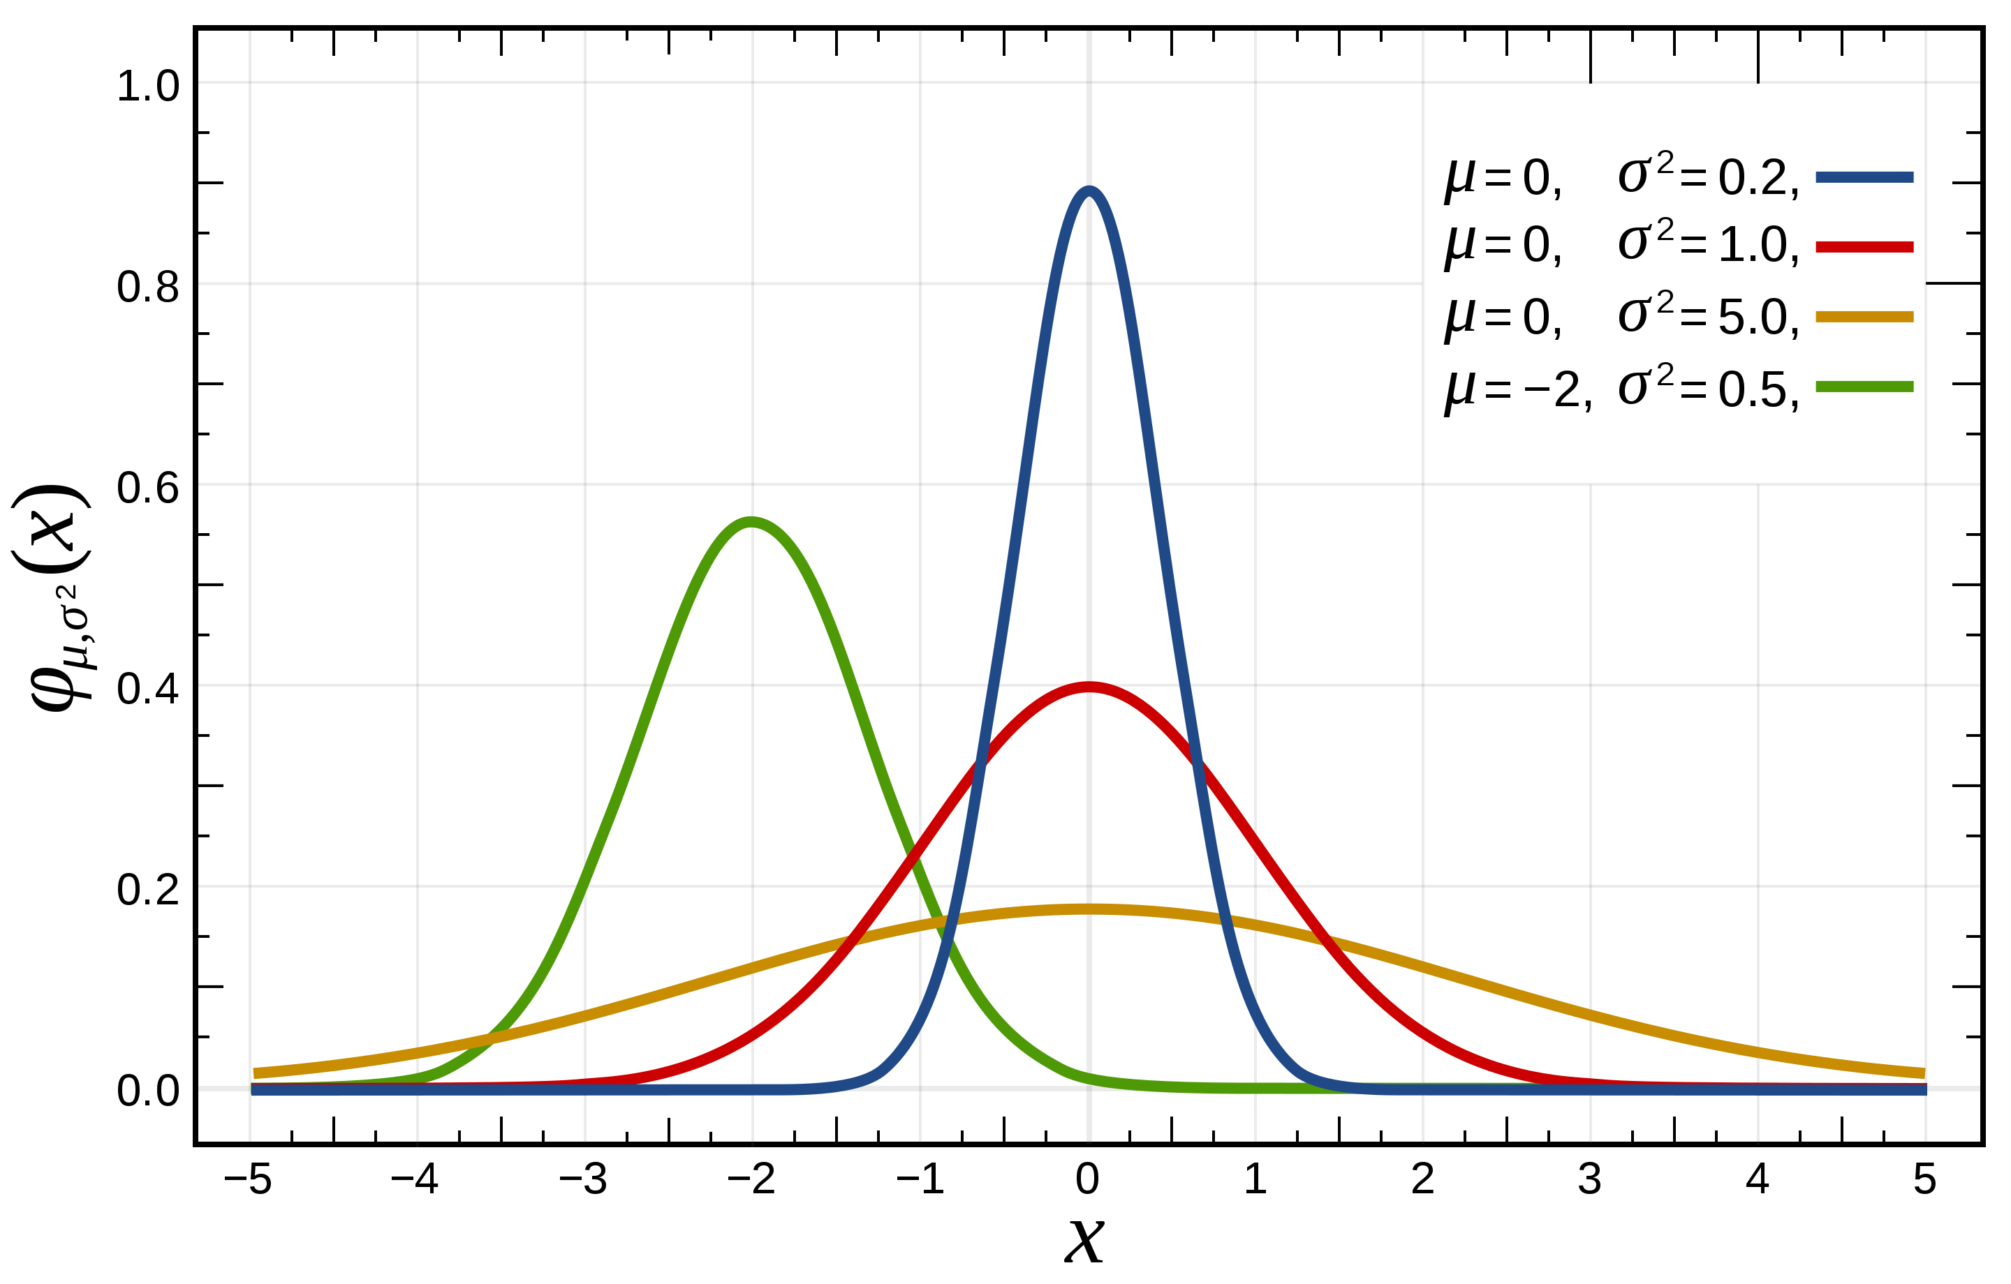
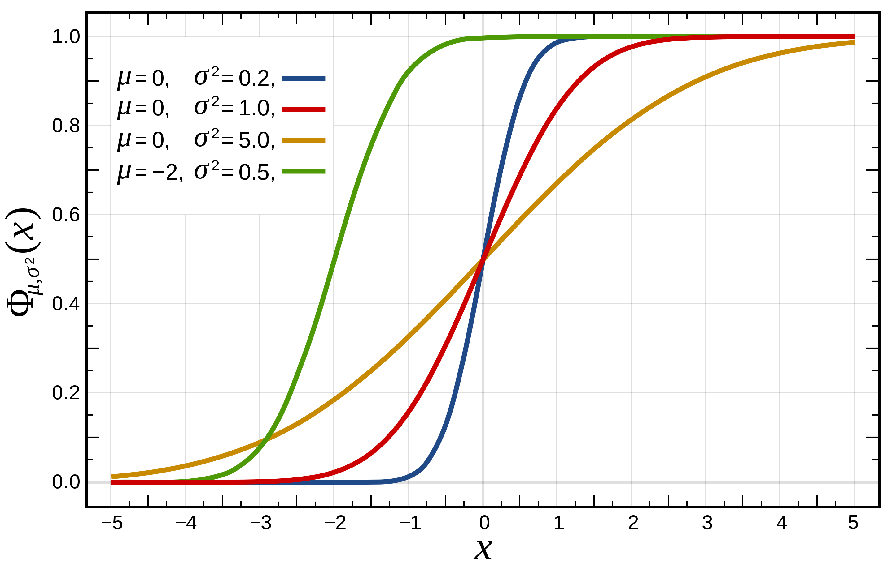
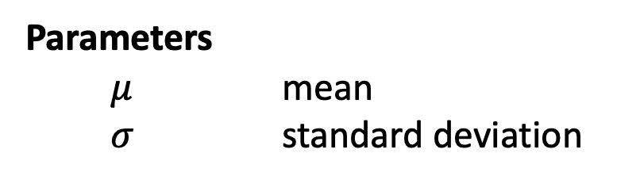
Gaussian Distribution
Also known as Normal distribution to emphasize special importance of Gaussian distribution that arises from Central Limit theorem
(cf. slide 15 of part 2)
Gaussian PDF
Probability density function
Parameters
$μ$ mean
$σ$ standard deviation
CDF
Cumulative distribution function
Gaussian error function
https://en.wikipedia.org/wiki/Normal_distribution
Christian Veelken Statistical Methods: Maximum Likelihood Fits 18

Slide 19
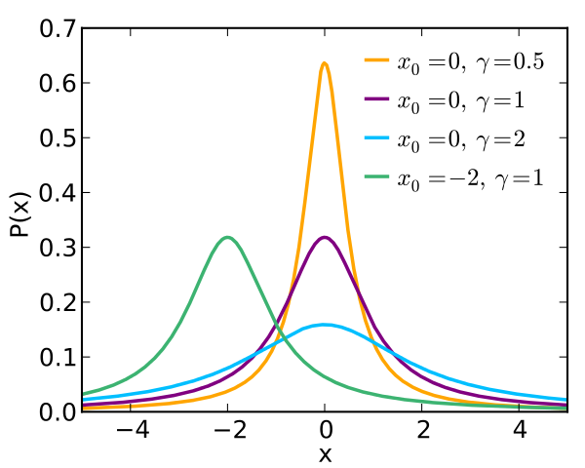
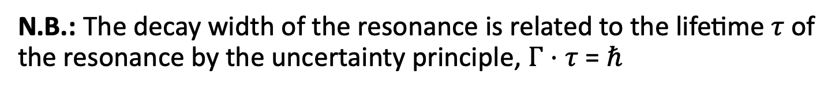
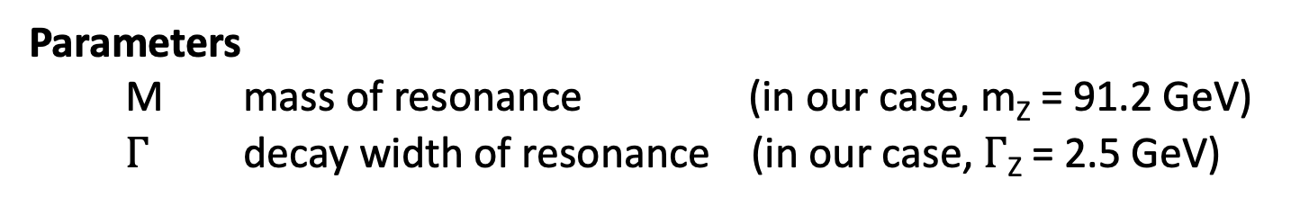
Breit-Wigner Distribution
Also known as Cauchy distribution
Cauchy PDF
Probability density function
Normalization constant
E is the center-of-mass energy of the particle
interaction that produces the resonance
(in our case, E is the mass of the dimuon system)
Parameters
M mass of resonance (in our case, m_{Z} = 91.2 GeV)
$Γ$ decay width of resonance (in our case, $Γ$_{Z} = 2.5 GeV)
http://pdg.lbl.gov/2018/listings/rpp2018-list-z-boson.pdf
N.B.: The decay width of the resonance is related to the lifetime $τ$ of the resonance by the uncertainty principle, $Γ⋅τ$ = $ℏ$
https://en.wikipedia.org/wiki/Relativistic_Breit-Wigner_distribution
Christian Veelken Statistical Methods: Maximum Likelihood Fits 19

Slide 20
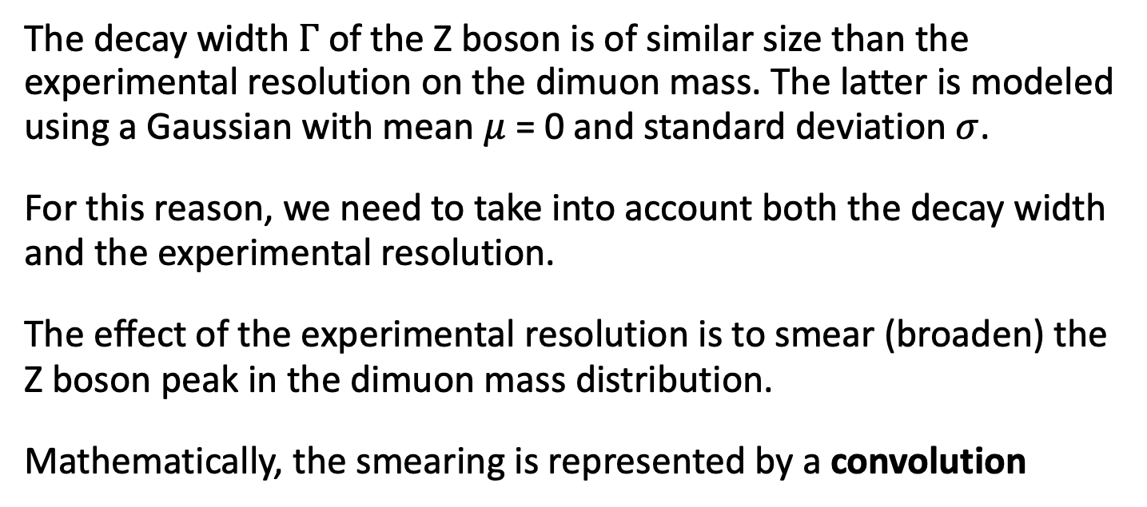
Convolution of Distributions
The decay width $Γ$ of the Z boson is of similar size than the experimental resolution on the dimuon mass. The latter is modeled using a Gaussian with mean $μ$ = 0 and standard deviation $σ$.
For this reason, we need to take into account both the decay width and the experimental resolution.
The effect of the experimental resolution is to smear (broaden) the Z boson peak in the dimuon mass distribution.
Mathematically, the smearing is represented by a convolution
PDF for convolution
Gaussian PDF
Breit-Wigner PDF
There usually exist no analytic solution for this integral
Christian Veelken Statistical Methods: Maximum Likelihood Fits 20

Slide 21
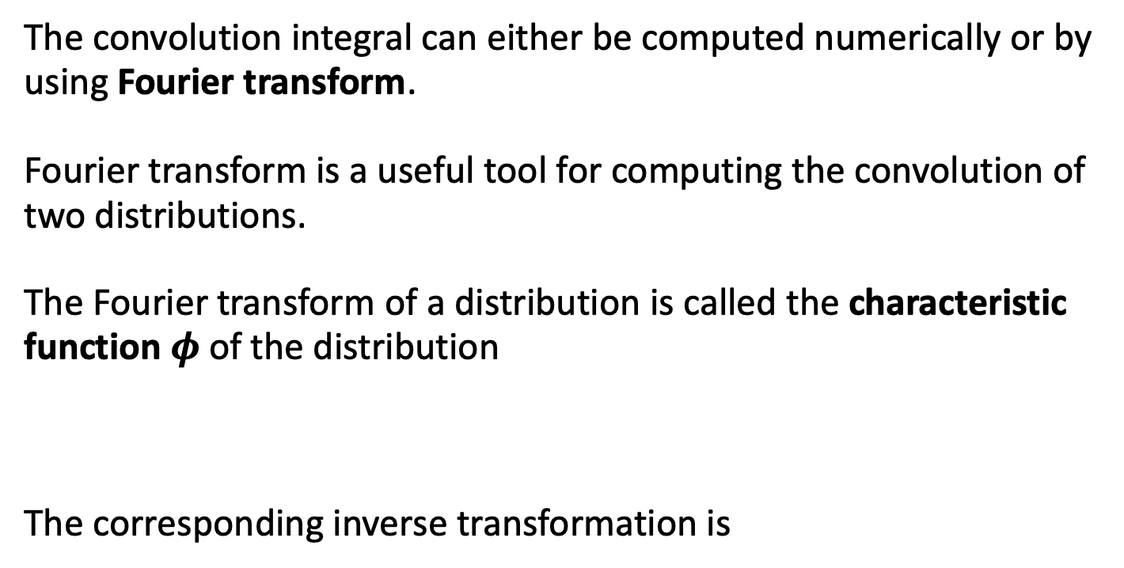
Convolution of Distributions
The convolution integral can either be computed numerically or by using Fourier transform.
Fourier transform is a useful tool for computing the convolution of two distributions.
The Fourier transform of a distribution is called the characteristic function $φ$ of the distribution
The corresponding inverse transformation is
Christian Veelken Statistical Methods: Maximum Likelihood Fits 21

Slide 22
Convolution of Distributions
The usefulness of the Fourier transform is due to the fact that the convolution of two distributions can be computed by taking the product of the characteristic functions of both distributions and applying an inverse Fourier transform on this product
The Fourier transform formalism is implemented in the RooFit tool, which allows for the fast computation of the convolution of distributions
Christian Veelken Statistical Methods: Maximum Likelihood Fits 22

Slide 23
Introduction to RooFit
RooFit is a toolkit for defining probabilistic models and for performing fits of these models to data.
The toolkit is written in C++. It has originally been developed for the BaBar experiment, which studied B mesons produced in e⁺e⁻ collisions at the Stanford Linear Accelerator Center (SLAC), but has since then become a standard tool for data analyses in high energy physics. RooFit is included in ROOT and can be used in Python also, with PyROOT.
A key concept of the RooFit toolkit is its modular object oriented design, which
provides flexibility and makes it easy to extent and adapt to the needs of different users
provides a close correspondence between C++ classes and mathematical objects, thereby making it quite intuitive to use
http://roofit.sourceforge.net/
Christian Veelken Statistical Methods: Maximum Likelihood Fits 23

Slide 24
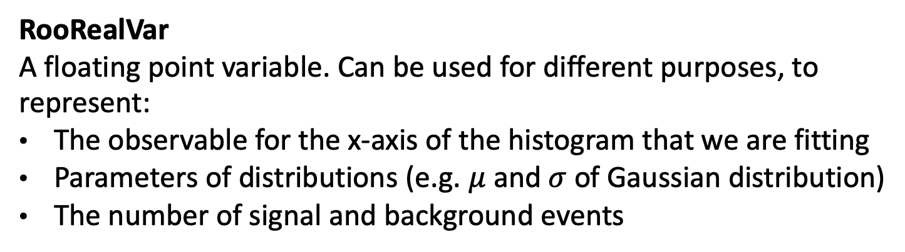
Important Classes in RooFit
RooRealVar
A floating point variable. Can be used for different purposes, to represent:
The observable for the x-axis of the histogram that we are fitting
Parameters of distributions (e.g. $μ$ and $σ$ of Gaussian distribution)
The number of signal and background events
RooAbsPdf
Abstract base class for distributions. Derived classes exist for the distributions most commonly used in high energy physics:
RooGaussian
RooBreitWigner
RooExponential
RooVogtian (convolution of Breit-Wigner and Gaussian)
RooDataHist
The histogram with the data that we are fitting
Christian Veelken Statistical Methods: Maximum Likelihood Fits 24

Slide 25
Usage of RooFit
Define the data that we are fitting
Name
Title
x-Axis range
RooRealVar observable( "observable" , ”Dimuon mass [GeV]” , xMin, xMax );
RooDataHist data("data", "data", RooArgList(observable) , histogram_mass);
Container that allows to pass either one or multiple objects;
here we telling RooFit that the dimuon mass observable represents the x-axis of the histogram
Define distribution for signal
double mZ = 91.2; // GeV
RooRealVar mean_gauss("mean_gauss", "Gaussian mean", mZ, 0.8*mZ, 1.2*mZ );
double width = 4.5; // GeV
RooRealVar sigma_gauss("sigma_gauss", "Gaussian resolution", width, 0., 2.*width);
RooGaussian model_S("model_S", "Signal model", observable , mean_gauss, sigma_gauss);
initial value, minimum, maximum
use Gaussian distribution for the signal
Here we are telling RooFit that the Gaussian is a function of the dimuon mass observable
Christian Veelken Statistical Methods: Maximum Likelihood Fits 25

Slide 26
Usage of RooFit
Define distribution for background
double lambda = -0.1;
RooRealVar lambda_exp("lambda_exp", "Background shape", lambda, 10.*lambda, 0. );
RooExponential model_B("pdf_B", "Background model", observable , lambda_exp);
initial value, minimum, maximum
use falling ($λ<0$) Exponential distribution for the background
Here we are telling RooFit that the Exponential is a function of the dimuon mass observable
N.B.: By defining the histogram that we are fitting as well as the signal and background distributions to depend on the same observable, we are “glueing” the probabilistic model for signal + background to the data
Christian Veelken Statistical Methods: Maximum Likelihood Fits 26

Slide 27
Usage of RooFit
Define fit model as sum of signal + background distributions
upper bound for sum of signal + background events in fit;
defining a loose upper bound improves convergence of the fit
double maxEvents = 2.*histogram_mass->Integral();
RooRealVar norm_S ("norm_S", "Signal yield", numEvents_S, 0., maxEvents);
RooRealVar norm_B ("norm_B", "Background yield", numEvents_B, 0., maxEvents);
RooAddPdf model_SplusB("model_SplusB", "Signal+background model",
RooArgList(model_S, model_B), RooArgList(norm_S, norm_B) );
This variable represents the number of signal events;
we initialize the variable with the number of expected signal events;
RooFit will set this variable later to the value that best fits the data
This variable represents the number of background events
This class represents the sum
of two (or more) distributions
Here we are telling RooFit that we want to fit the data to the sum of signal + background distributions
☞ Important Point
Signal and background need to be passed in the same order in both RooArgLists!
Christian Veelken Statistical Methods: Maximum Likelihood Fits 27

Slide 28
Usage of RooFit
Execute fit
Reduce print-out
model_SplusB.fitTo(data, PrintLevel(-1) );
Print number of signal events in the data, as determined by fit
std::cout << "fit results:" << std::endl;
std::cout << " S = " << norm_S.getVal();
if ( norm_S.hasAsymError() ) {
std::cout << " + " << norm_S.getErrorHi() << " - " << norm_S.getErrorLo();
} else {
std::cout << " +/- " << norm_S.getError();
}
std::cout << std::endl;
The uncertainty on the number of signal events may be “asymmetric” in general,
i.e. different for the upper and lower bound
/home/veelken/public/PhyStat-101/toyMC_RooFit_model.C
Christian Veelken Statistical Methods: Maximum Likelihood Fits 28

Slide 29
Usage of RooFit
Make “postfit” plot that compares fit model to data
Create new plot with dimuon mass observable on x-axis
RooPlot* frame1 = observable.frame();
data.plotOn(frame1);
model_SplusB.plotOn(frame1);
model_SplusB.plotOn(frame1,
Components(model_B), LineStyle(ELineStyle::kDashed) );
TCanvas canvas1;
canvas1.cd();
frame1->Draw();
canvas1.SaveAs("toyMC_fit.png");
Show histogram, that we fitted, on the plot
Show distribution for sum of signal + background on the plot
Show distribution for background separately on the plot, using a dashed line
Save plot in PNG file (toyMC_fit.png)
/home/veelken/public/PhyStat-101/toyMC_RooFit_plotting.C
Christian Veelken Statistical Methods: Maximum Likelihood Fits 29

Slide 30
Usage of RooFit
Make a plot of the likelihood function
Use four threads in parallel
RooAbsReal* nll = model_SplusB.createNLL(data, NumCPU(4) );
RooMinuit minuit(*nll);
minuit.setPrintLevel(-1);
minuit.migrad();
RooPlot* frame2 = norm_S.frame(Bins(10), Range(0.5*numEvents_S, 1.5*numEvents_S) );
nll->plotOn(frame2, ShiftToZero() );
RooAbsReal* nll_profiled = nll->createProfile(norm_S);
nll_profiled->plotOn(frame2, LineColor(kRed));
frame2->SetMinimum(0.);
frame2->SetMaximum(25.);
TCanvas canvas2; canvas2.cd();
frame2->Draw();
canvas2.SaveAs("toyMC_nll.png");
Initialize MINUIT algorithm for the minimization of the likelihood as function of the number of background events
Show likelihood as function of the number of signal events,
for fixed number of background events
Define x-axis range
Show likelihood function for the case that the number of background events is fixed;
adjust y-axis such that minimum of the likelihood function is at y=0
Compute and show “profiled” likelihood, which the number of background events is reoptimized for each value of the number of signal events
Define y-axis range
Save plot in PNG file (toyMC_nll.png)
Christian Veelken Statistical Methods: Maximum Likelihood Fits 30

Slide 31

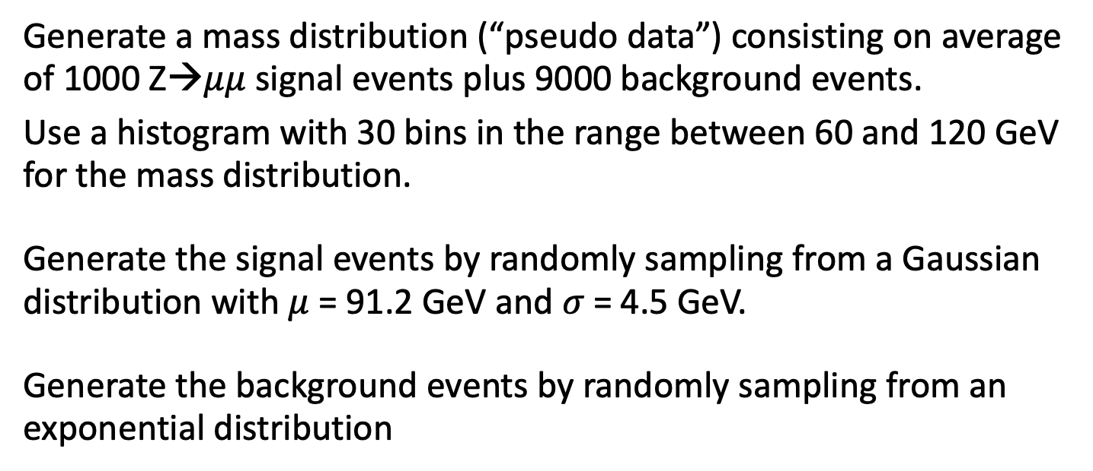
Exercise
Generate a mass distribution (“pseudo data”) consisting on average of 1000 Z→$μμ$ signal events plus 9000 background events.
Use a histogram with 30 bins in the range between 60 and 120 GeV for the mass distribution.
Generate the signal events by randomly sampling from a Gaussian distribution with $μ$ = 91.2 GeV and $σ$ = 4.5 GeV.
Generate the background events by randomly sampling from an exponential distribution
with $λ$ = 0.1 GeV ⁻¹ and normalization constant
Christian Veelken Statistical Methods: Maximum Likelihood Fits 31

Slide 32
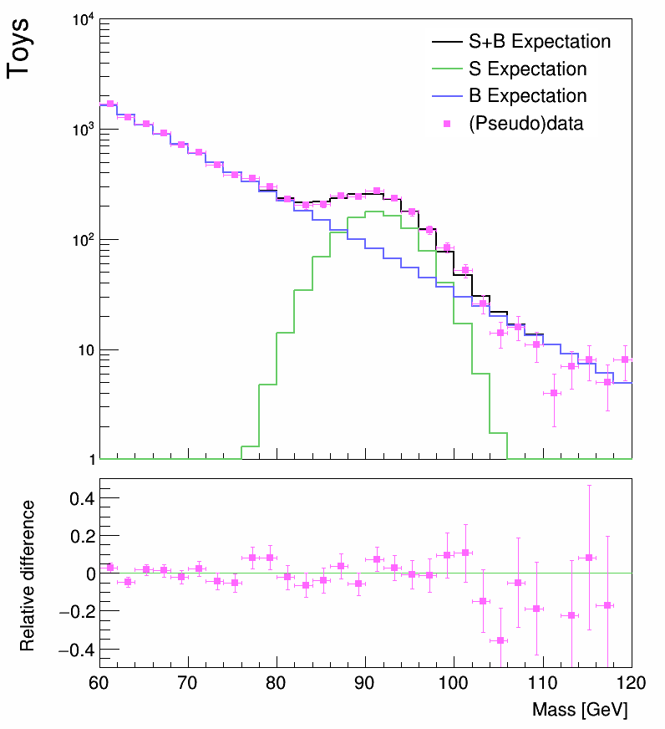
Exercise
Make a plot that compares the generated distribution with the histogram that is expected in the limit of infinite event statistics
(like you did for the exercise on random numbers in part 2)
N.B.: The number of background events expected in a bin j that covers the interval [a,b] is
Christian Veelken Statistical Methods: Maximum Likelihood Fits 32

Slide 33
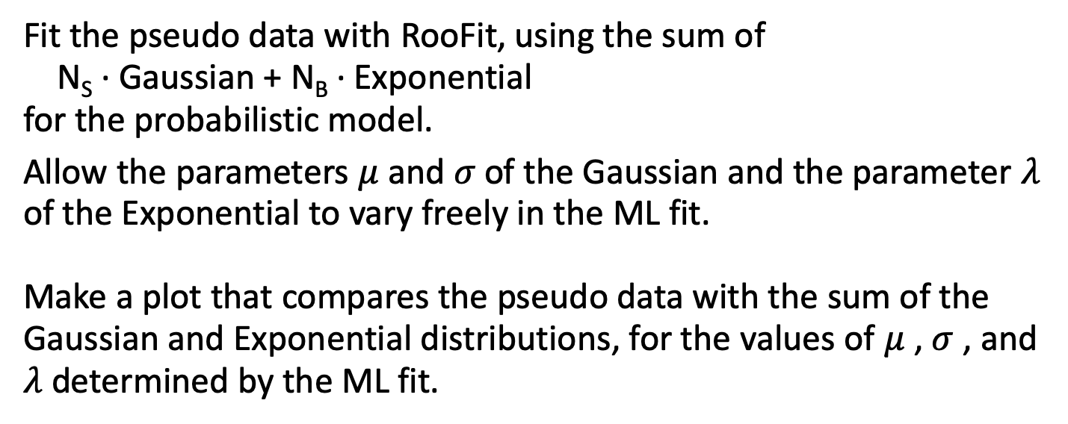
Exercise
Fit the pseudo data with RooFit, using the sum of
N_{S} ∙ Gaussian + N_{B} ∙ Exponential
for the probabilistic model.
Allow the parameters $μ$ and $σ$ of the Gaussian and the parameter $λ$ of the Exponential to vary freely in the ML fit.
Make a plot that compares the pseudo data with the sum of the Gaussian and Exponential distributions, for the values of $μ$ , $σ$ , and $λ$ determined by the ML fit.
Christian Veelken Statistical Methods: Maximum Likelihood Fits 33

Slide 34
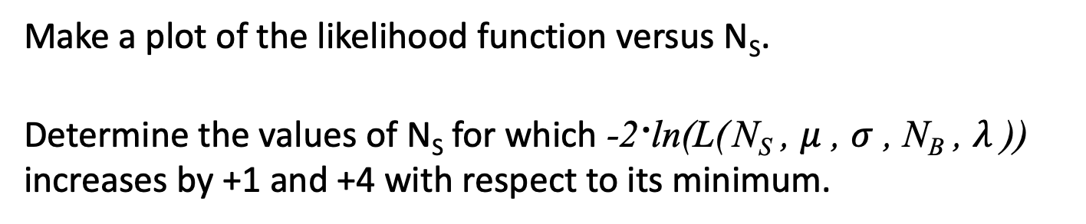
Exercise
Make a plot of the likelihood function versus N_{S}.
Determine the values of N_{S} for which -2∙ln(L( N_{S} , $μ$ , $σ$ , N_{B} , $λ$ )) increases by +1 and +4 with respect to its minimum.
Christian Veelken Statistical Methods: Maximum Likelihood Fits 34

Slide 35
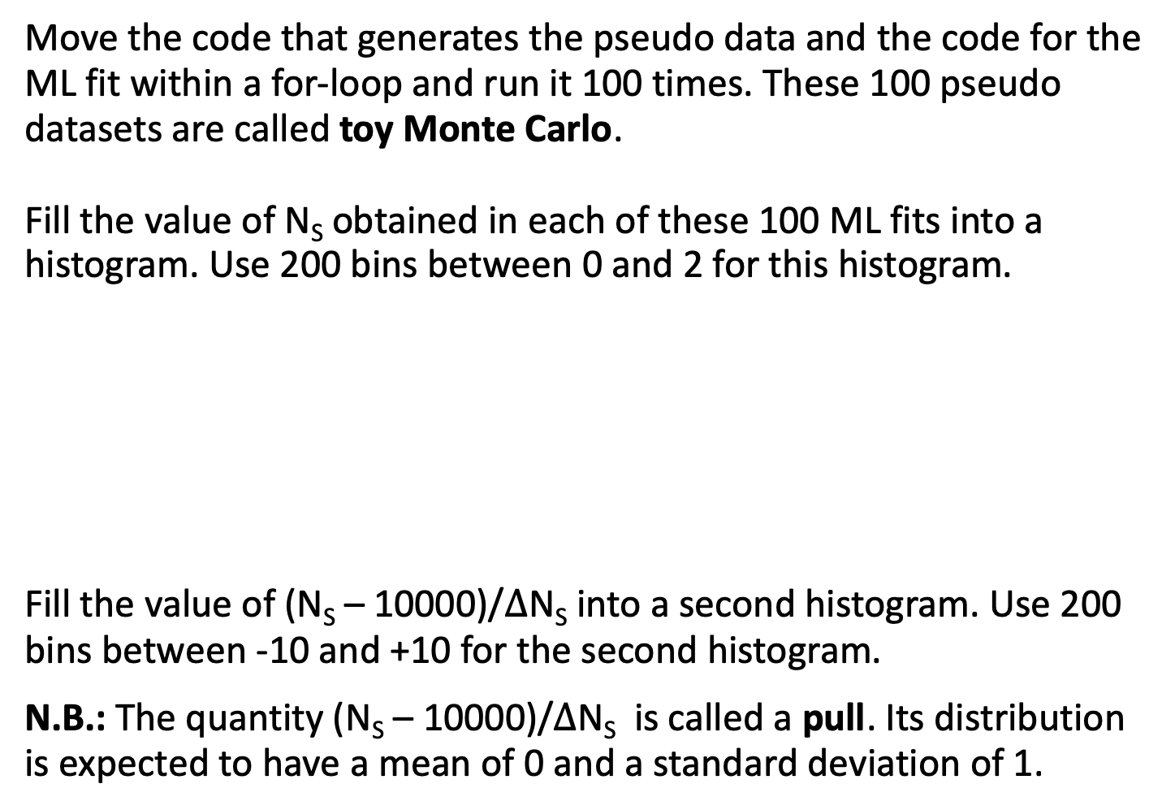
Bonus: Part 1
Move the code that generates the pseudo data and the code for the ML fit within a for-loop and run it 100 times. These 100 pseudo datasets are called toy Monte Carlo.
Fill the value of N_{S} obtained in each of these 100 ML fits into a histogram. Use 200 bins between 0 and 2 for this histogram.
Fill the value of (N_{S} – 10000)/$Δ$N_{S} into a second histogram. Use 200 bins between -10 and +10 for the second histogram.
N.B.: The quantity (N_{S} – 10000)/$Δ$N_{S} is called a pull. Its distribution is expected to have a mean of 0 and a standard deviation of 1.
Christian Veelken Statistical Methods: Maximum Likelihood Fits 35

Slide 36
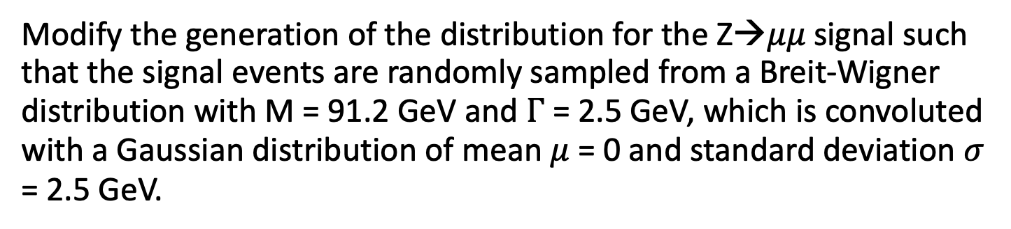
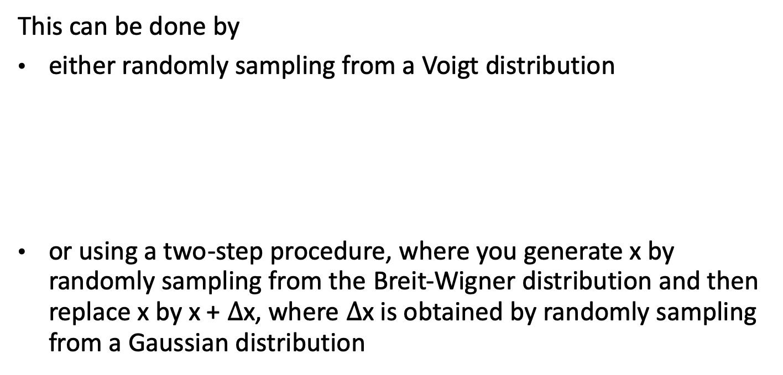
Bonus: Part 2
Modify the generation of the distribution for the Z→$μμ$ signal such that the signal events are randomly sampled from a Breit-Wigner distribution with M = 91.2 GeV and $Γ$ = 2.5 GeV, which is convoluted with a Gaussian distribution of mean $μ$= 0 and standard deviation $σ$ = 2.5 GeV.
This can be done by
either randomly sampling from a Voigt distribution
or using a two-step procedure, where you generate x by randomly sampling from the Breit-Wigner distribution and then replace x by x + $Δ$x, where $Δ$x is obtained by randomly sampling from a Gaussian distribution
https://en.wikipedia.org/wiki/Voigt_profile
https://root.cern.ch/root/html524/TMath.html#TMath:Voigt
Note that the implementation in TMath::Voigt assumes that the Breit-Wigner distribution is centered at 0, so you need to pass x – m_{Z} as the first function argument when calling TMath::Voigt
Christian Veelken Statistical Methods: Maximum Likelihood Fits 36

Slide 37
Bonus: Part 2
Make a plot that compares the generated distribution with the histogram that is expected in the limit of infinite event statistics
N.B.: The number of signal events expected in a bin j that covers the interval [a,b] needs to be computed using numeric integration. Use the class TF1 for this purpose
https://root.cern.ch/doc/master/classTF1.html
Christian Veelken Statistical Methods: Maximum Likelihood Fits 37

Slide 38
Bonus: Part 2
When you define the probabilistic model for the ML fit in RooFit,
you can either use a Voigtian distribution
or you can compute the convolution of a Breit-Wigner with a Gaussian distribution using the Fourier transformation method
https://root.cern.ch/doc/master/classRooVoigtian.html
https://root.cern.ch/doc/master/classRooBreitWigner.html
https://root.cern.ch/doc/master/classRooFFTConvPdf.html
Christian Veelken Statistical Methods: Maximum Likelihood Fits 38

